Slide 1
Smart Eye
Supervised by: Dr. Usman Hashmi
Project By:
Ahmad Naeem Cheema
23017
Notes:
To use this title animation slide with a new image simply 1) move the top semi-transparent shape to the side, 2) delete placeholder image, 3) click on the picture icon to add a new picture, 4) Move semi-transparent shape back to original position, 5) Update text on slide.

Slide 2
INTRODUCTION
The Smart Eye is similar to the traditional white cane used by the visually impaired people.
But
It will also provide smart features like object detection and ditch detection etc.

Slide 3
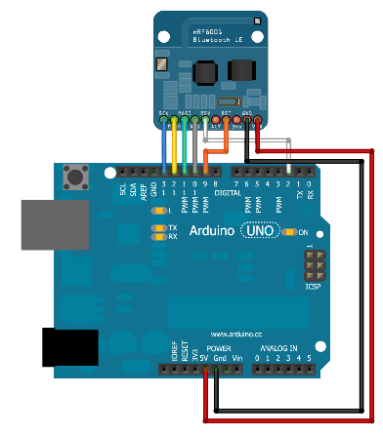
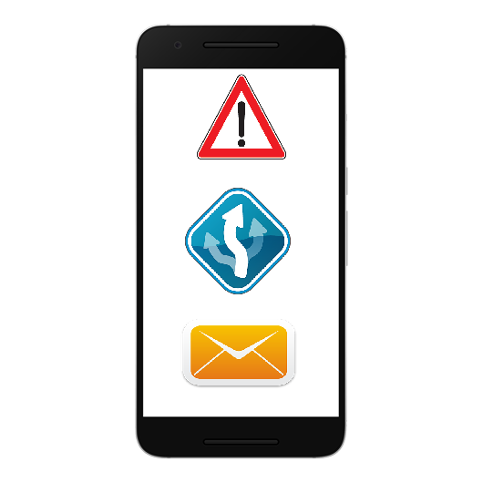
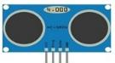

OBJECTIVES
Arduino Microcontroller
Bluetooth Connection
Android Smart Phone

Slide 4
SCOPE
THE SCOPE
Collision Detection
Ditch Detection
Accident Detection
Emergency Button
Stick Locator
GPS Tracking

Slide 5
Arduino
Components

Slide 6
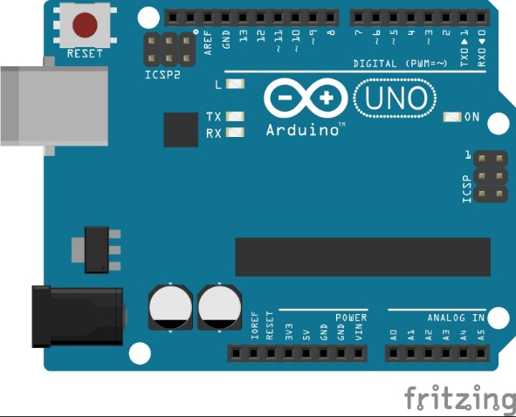
Arduino
Arduino UNO
A Microcontroller Board
Equipped with Digital and Analog Pins that can be interfaced to work according to the users needs

Slide 7
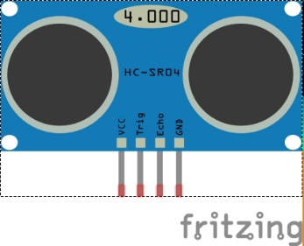
Arduino
HC-04 Ultrasonic Sensor
Ranging Sensor
Provides 2cm to 400cm Measurement Function
Triggers a High Frequency Sound and then receives back how far the sound travelled

Slide 8
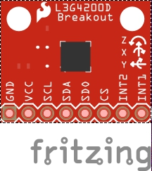
Arduino
MPU-6050 Gyro Sensor
Gyro Sensor
Can detect the X Y Z and –X –Y –Z Axis

Slide 9
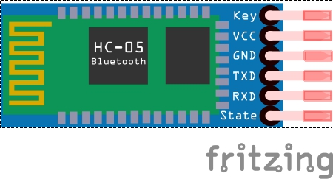
Arduino
HC-05 Bluetooth Module
Bluetooth Module
Transmits and Receives all the data of the Arduino

Slide 10

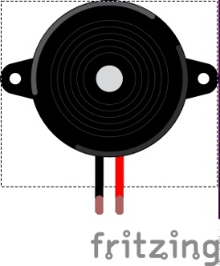
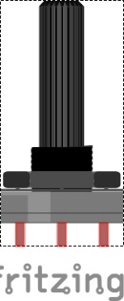
Arduino
Other Components
Push Button
Buzzer
Potentiometer

Slide 11
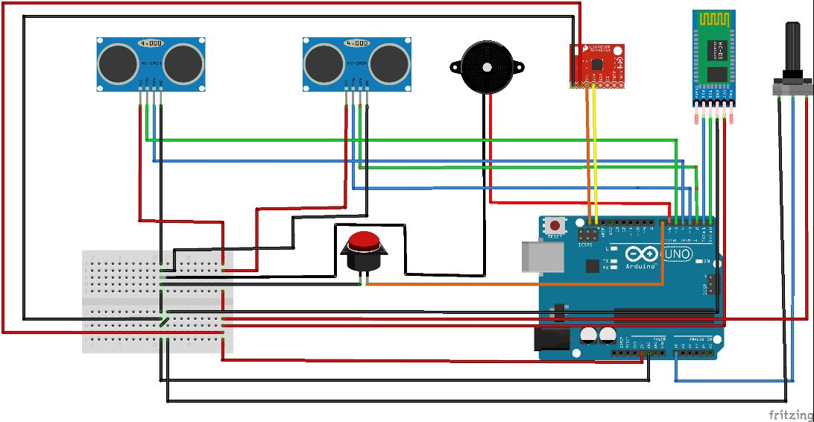
Arduino
How is the Arduino Working?

Slide 12
Android
How the Android is working
The Login/Signup Function
The GPS Tracking Function
The Bluetooth Function
Firebase Connection is Established
Login or Sign-up Details are entered
SMS is sent to verify the phone number
User Logs In
User Logs In
Adds a Person
Selects the Person
Views GPS Location
User Logs In
Connects to the Bluetooth of Arduino
Person gets alert notifications

Slide 13
Android
Common Functions

Slide 14
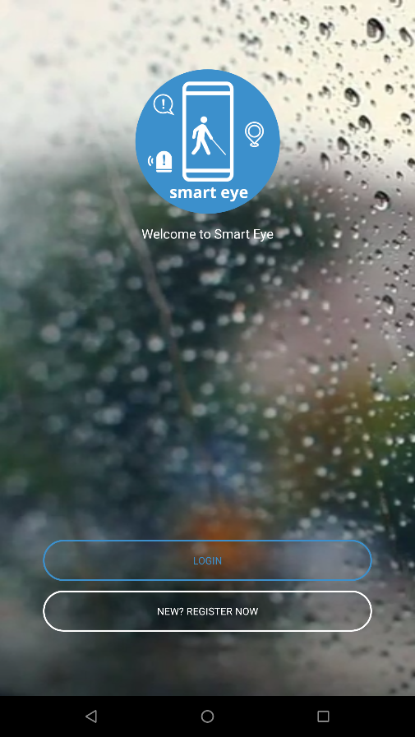
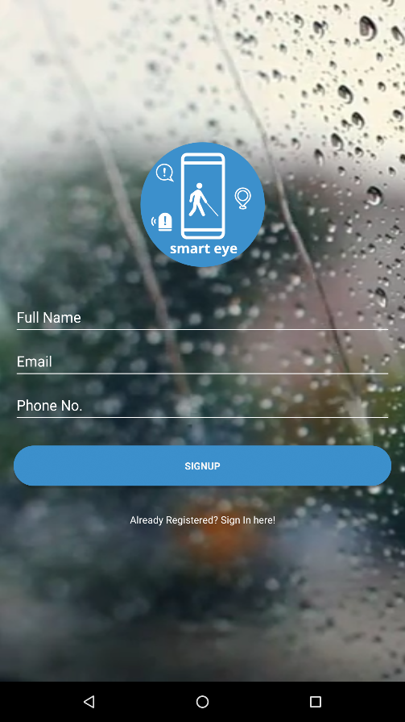
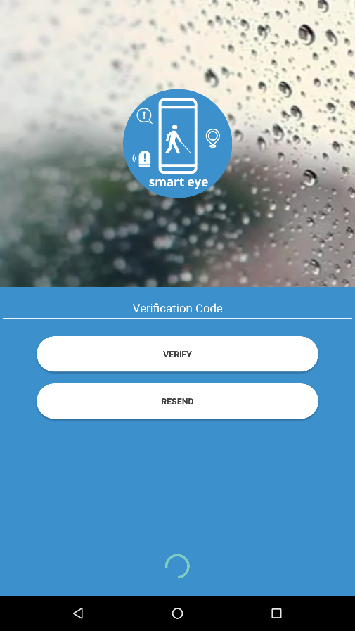
Android
Sign-Up Function

Slide 15
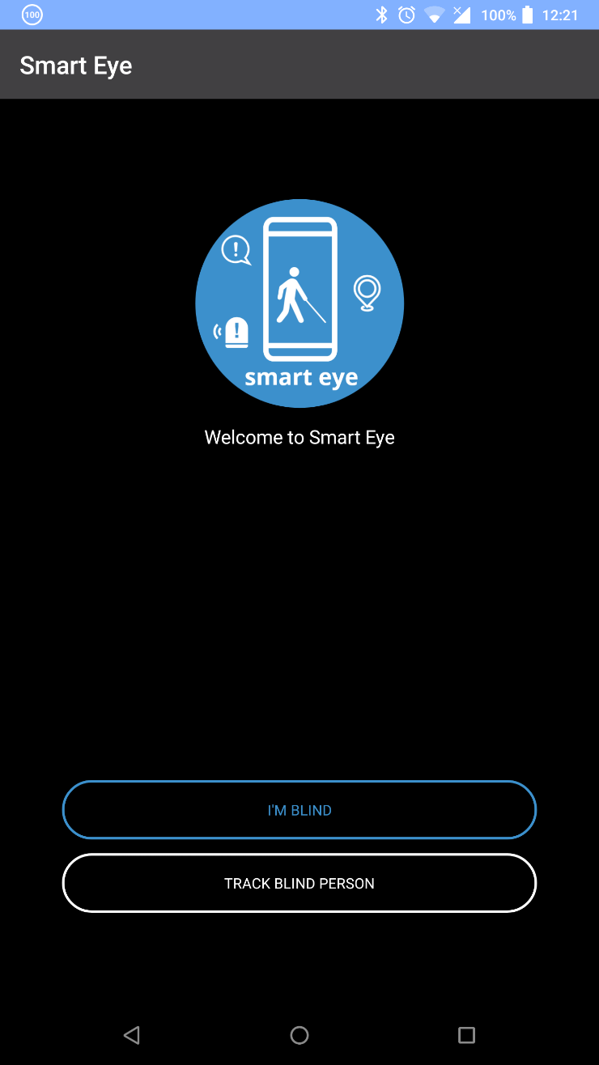

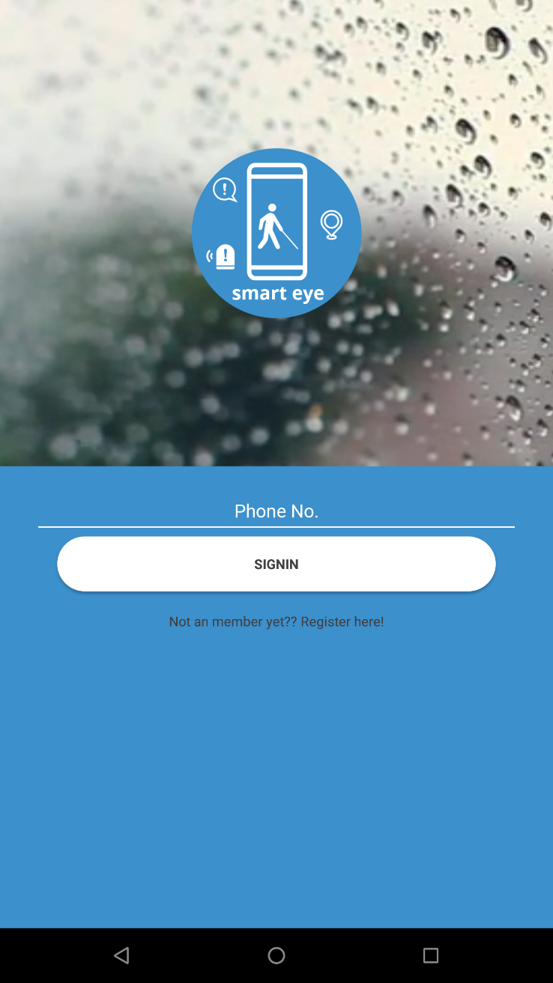
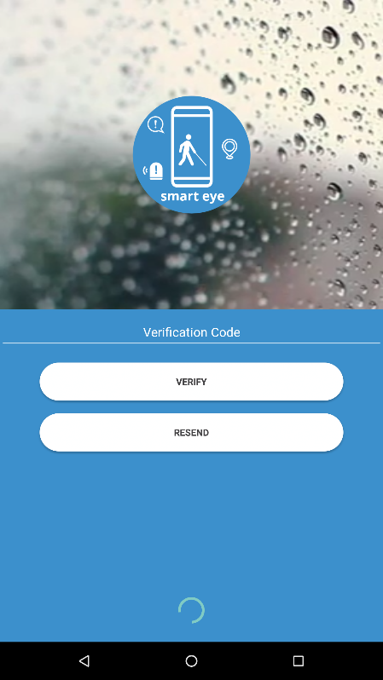
Android
Login Function

Slide 16
Android
Blind Person Functions

Slide 17
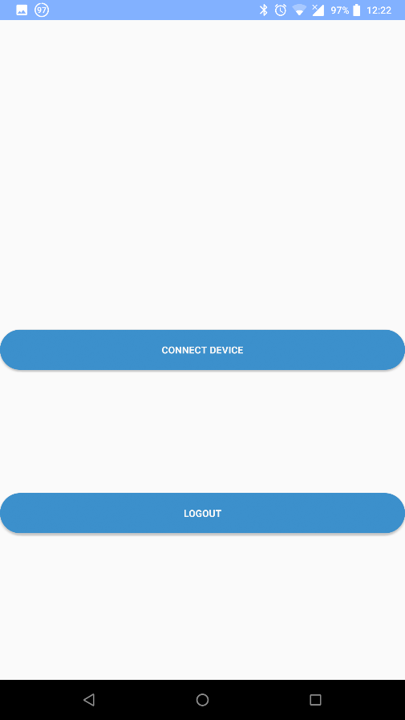
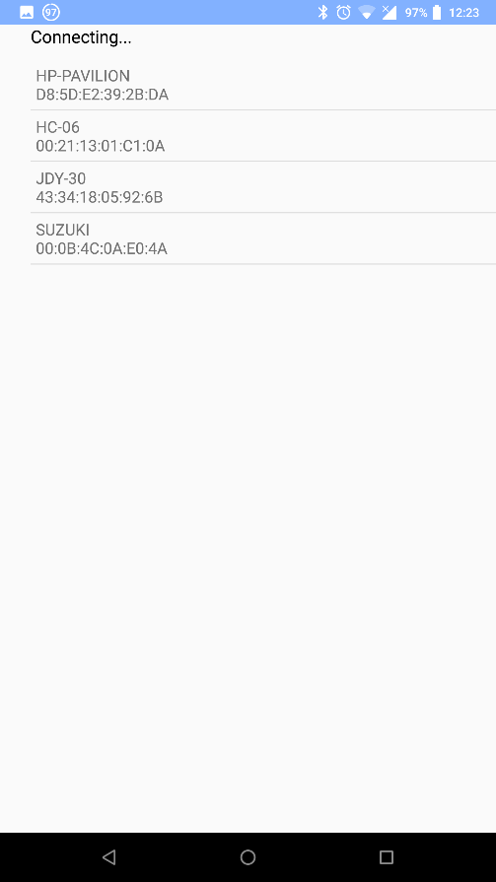
Android
Connect Bluetooth Device

Slide 18
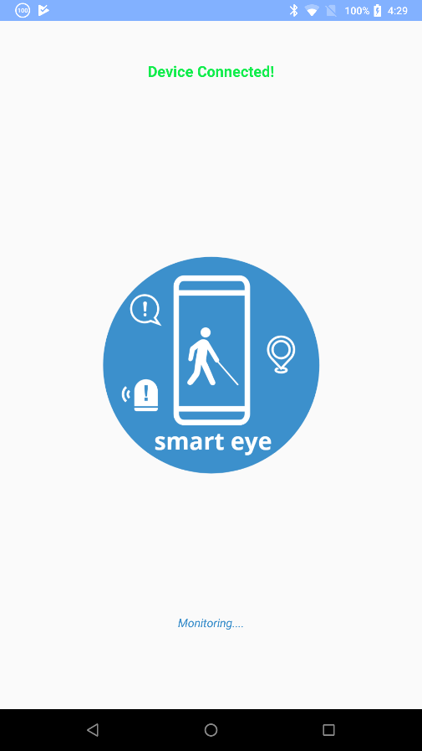
Android
Alert Generation

Slide 19
Android
Emergency Contact Functions

Slide 20
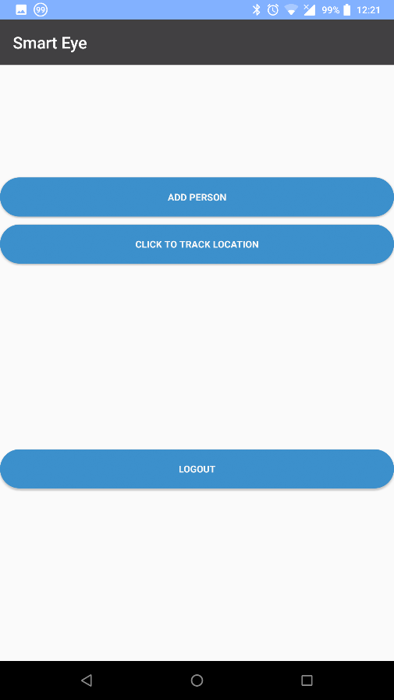
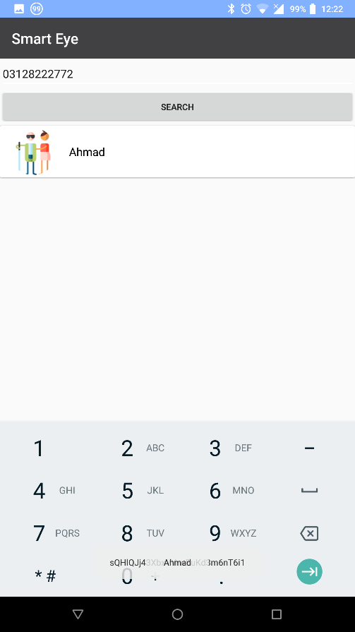
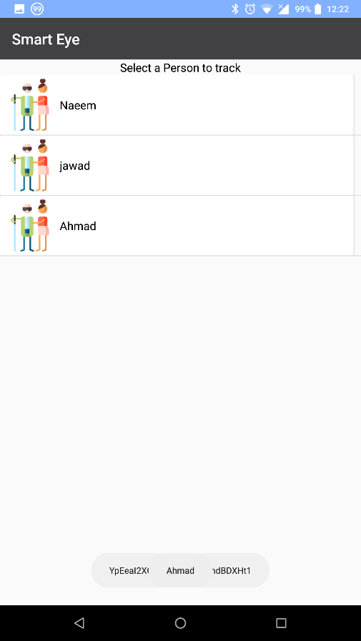
Android
Add a Blind Person

Slide 21
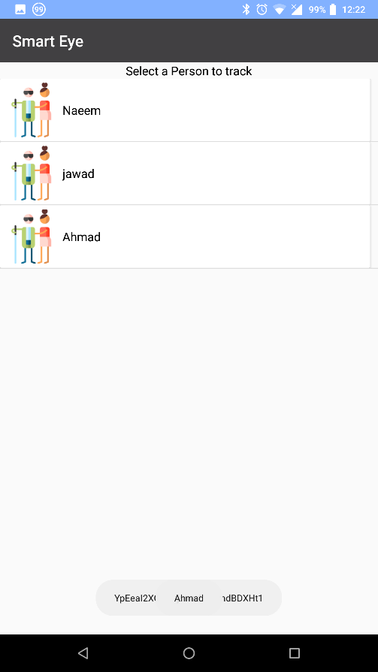
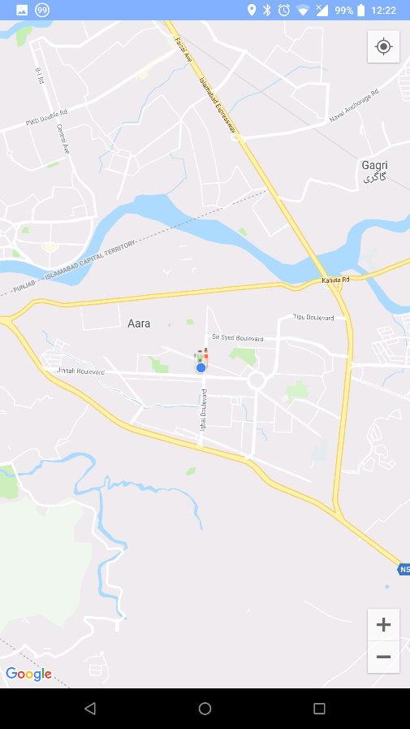
Android
Track a Blind Person

Slide 22
Android
Additional Features
Back Press Check
Saved State
Alert for Blind Person
Single Back press is disabled
The User would have to press back 2 times to exit the application
If a user logs in and then goes to another app Smart Eyes will still be logged
If an Emergency Contact adds a blind person the blind person can check who has added him/her by long pressing on the Blind Home Screen.

Slide 23
Thank You!
Notes:
To use this title animation slide with a new image simply 1) move the top semi-transparent shape to the side, 2) delete placeholder image, 3) click on the picture icon to add a new picture, 4) Move semi-transparent shape back to original position, 5) Update text on slide.

